Slide 1
Azure DevOps Training

Slide 2
Presented By: DevOps IT Team
We offer:
Azure DevOps Training
DevOps support across Enterprise
Dashboarding
Work Items and Backlog Tracking guidelines
Kanban Board & Sprint Planning assistance
Assistance in forming Queries
Open Source Integration Support
Azure Pipeline Governance
CI/CD for projects
Git Best Practices
For support contact: palakkamal.joshi@newwave.io
vignesh.sunderrajan@newwave.io

Slide 3
Agenda
What is DevOps?
Why DevOps culture is so important?
Why are Enterprises moving to DevOps?
What is Agile?
Azure DevOps
Getting started with Azure DevOps

Slide 4
Agenda – cont’d
Permissions and Groups
Azure boards (with Demo videos)
What are different work items?
Kanban Board Planning
Backlogs
Sprint and Capacity Planning
Queries
What is Version Control?
Git best practices
CI/CD
DevSecOps and CI Flow

Slide 5
What is DevOps???
People. Process. Products.

Slide 6
“DevOps is the UNION of people,
process, and products to
enable continuous delivery
of value to your end users”
- By Donovan Brown

Slide 7
Why DevOps culture is so important???
DevOps Is Not a Technology; It's an Evolving IT Culture!!!

Slide 8
Why DevOps culture is so important?
Practices
Culture
Focusses to create multidisciplinary teams that work together with shared and efficient practices and tools
Encourages collaboration, agile planning, continuous delivery, continuous monitoring and continuous feedback.
In transitioning to DevOps, the SDLC is accelerated.
DevOps teams use monitoring and telemetry to gather evidence in production, real time.
Encourages the fail-fast principle, work in small batches, focus on improving the end-to-end delivery of customer value

Slide 9
Why are Enterprises moving to DevOps???

Slide 10
Why are Enterprises moving to DevOps?
Triggers Innovation
Emphasizes on Collaboration & Communication
Focuses on Productivity
Rise of Continuous Everything
Automation!!! Automation!!! Automation!!!

Slide 11
What is Agile?

Slide 12
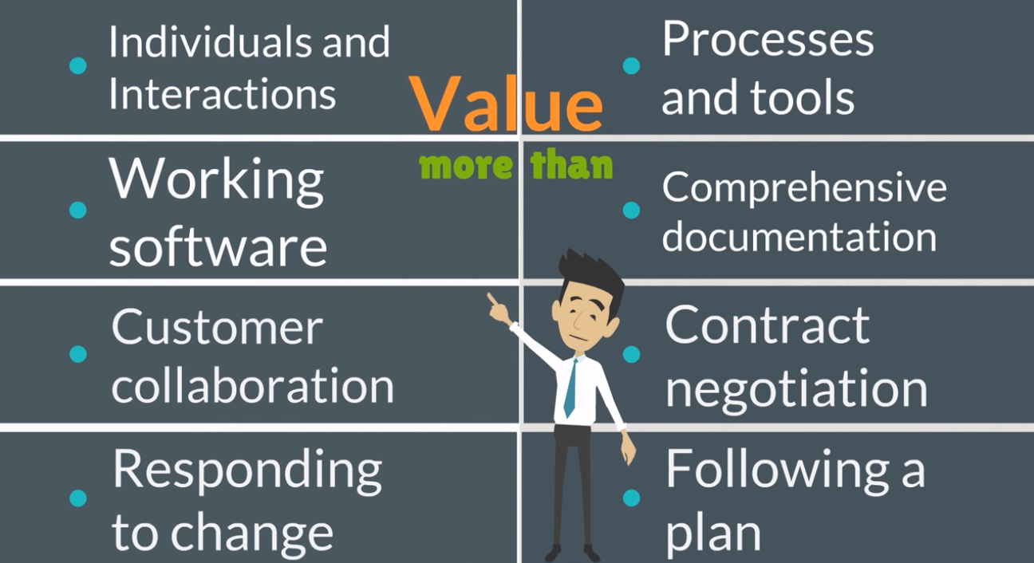
What is Agile?
Set of values and principles.
Ability to move quickly and easily.
Collection of beliefs used by teams in decision making for software development.
Focused more on thinking, interacting and collaborating.

Slide 13
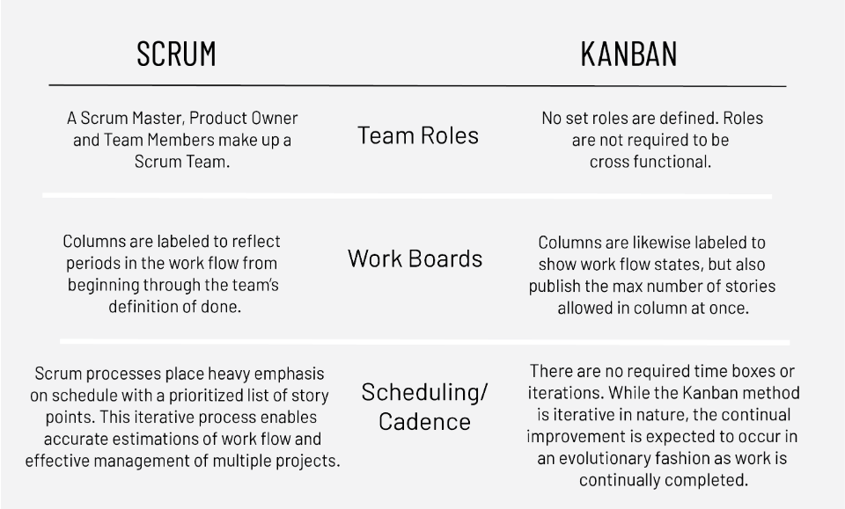
Agile Methodologies
Work in Sprints, implement Scrum
To track work, implement Kanban

Slide 14
Azure DevOps

Slide 15
Scalability
Traceability
Transparency
Flexibility
Extensibility
Code tracking, planning and collaboration
Accountability
Azure DevOps
Integrated Cloud Service for collaborating on code development providing access to set of features through web browser or IDE client.
Automation
Continuous Delivery
Continuous Deployment
Continuous Testing
Continuous Integration

Slide 16
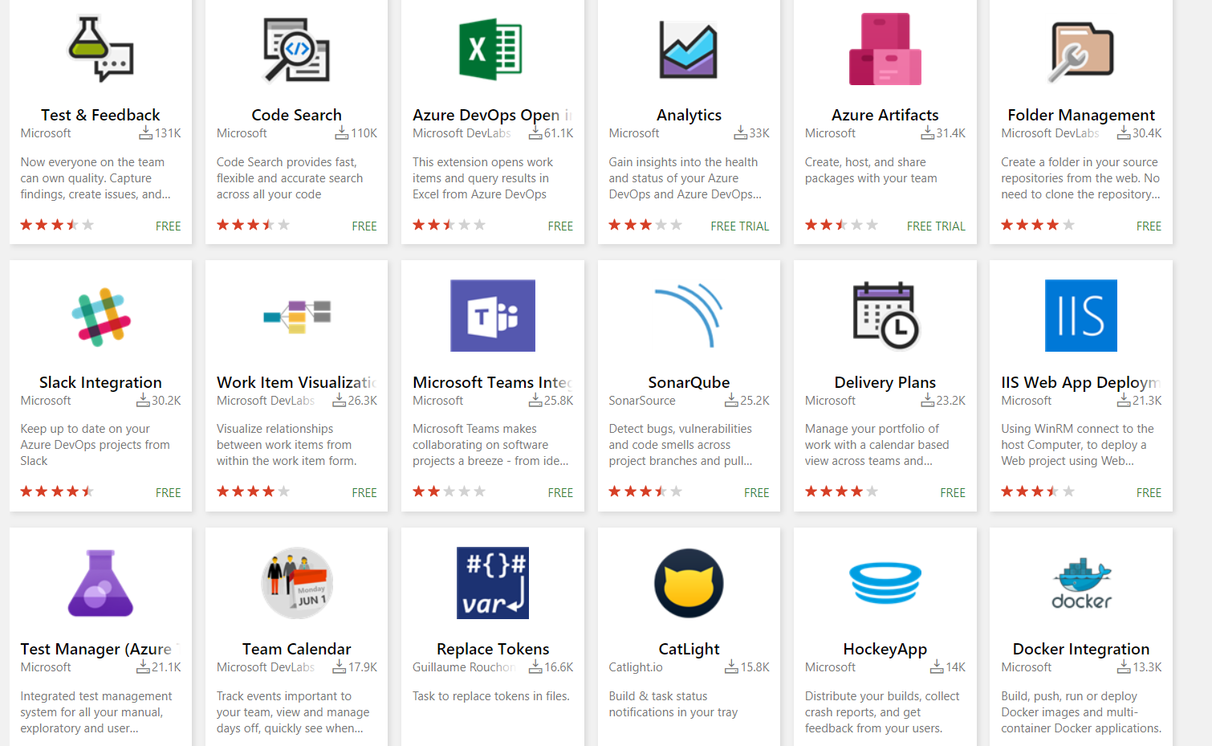
Azure DevOps Extensibility
There are number of extensions which can be easily added and integrated to interact with Azure DevOps.
The Visual Studio Marketplace is where extensions are published.
Total 963 extensions are available currently.

Slide 17
Getting started with Azure DevOps

Slide 18
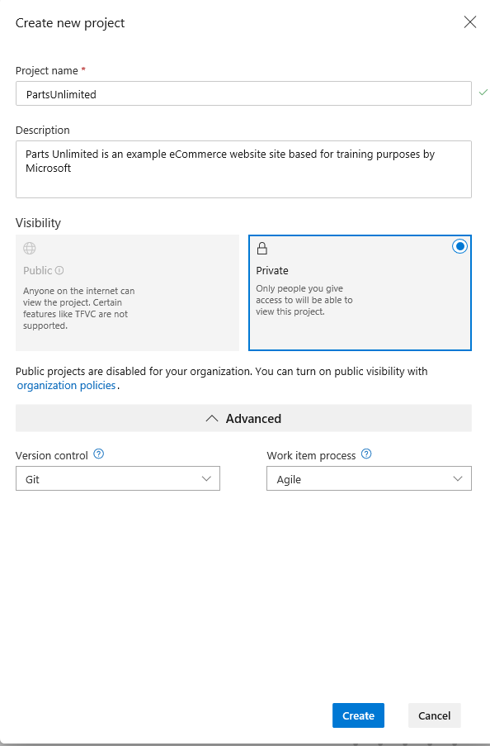
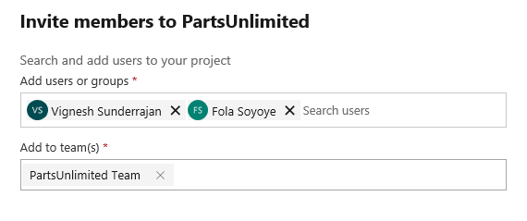
Creating a project
Add members to your team
Configure Boards
Stakeholder: Project Administrator or Team Admin

Slide 19
Permissions and Groups

Slide 20
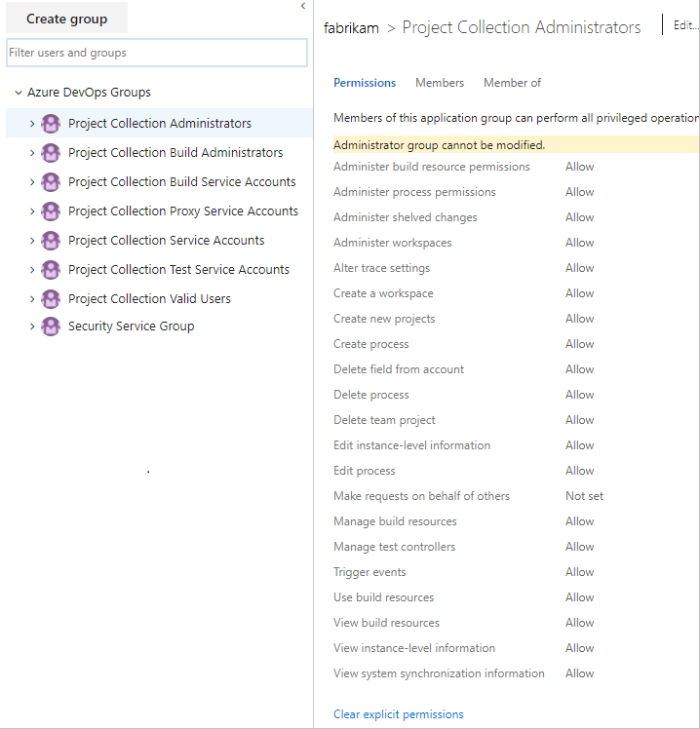
Permissions and Groups
Permissions can be granted directly to an individual, or to a group.
There are several built in groups in Azure DevOps (as shown in the picture).
Project Admin can change the permissions for a group or for an individual member from Project Settings → Security
Stakeholder: Project Administrator

Slide 21
Azure Boards

Slide 22
What are different work items???

Slide 23

Types of work items with hierarchy
Epics
Features
User Story
Bugs
Tasks
A business initiative to be accomplished.
Examples:
Increase customer engagement
Improve and simplify the user experience
Support mobile apps
A shippable component of the software
Examples:
Support text alerts
Refresh the web portal with new look and feel
Support text alerts
Defines the applications, requirements, and elements that teams need to create
Example:
Add quick links
Bugs can be added to a Features or User Stories once it is tested by the tester or reported by the clients.
Example:
YouTube quick link not working
User story or bug can be further broken down to tasks specifying different steps to resolve it.
Add tasks from the Backlog or
Taskboard (Sprints)
Example:
Research about adding quick links
Epic
Feature
User Story
Bug
Task

Slide 24
Kanban Board Planning

Slide 25






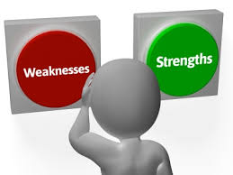
Helps understand what does this business hope to accomplish?
Focusses on how are we going to accomplish it?
Helps an organization chart a course for the achievement of its goals.
Why is planning important???
Promotes team building and a spirit of cooperation.
Maximize productivity with efficient use of resources.
Encourages the development of “what-if” scenarios thereby managing risk and uncertainty.
Provides a realistic view of their current strengths and weaknesses

Slide 26
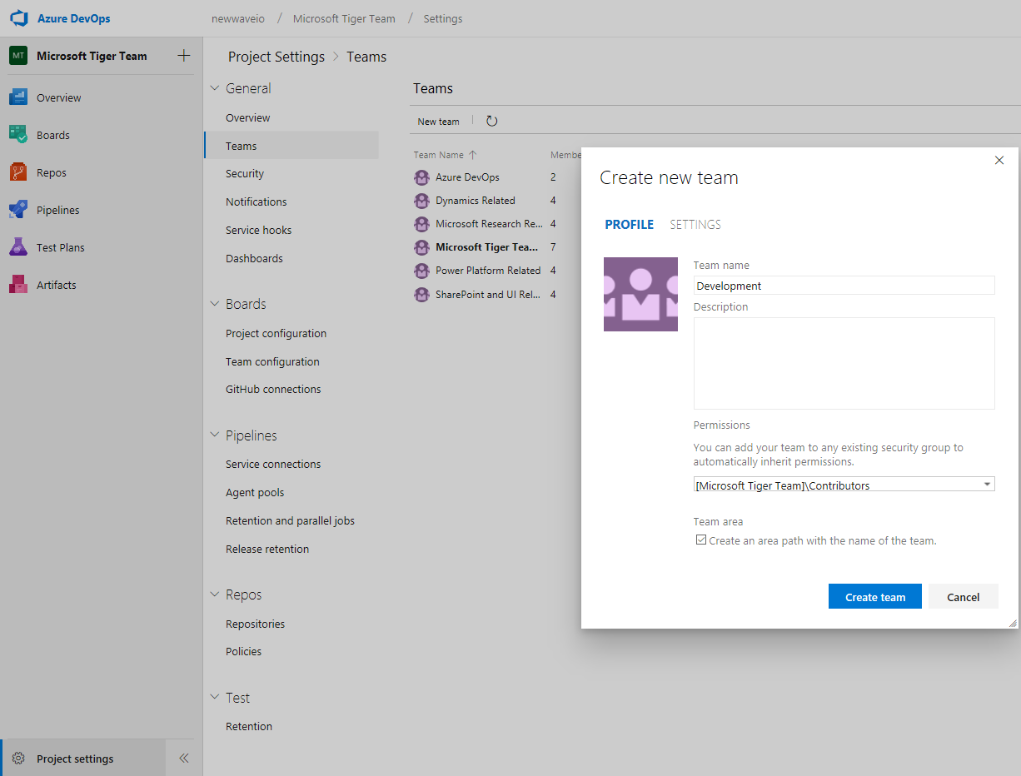
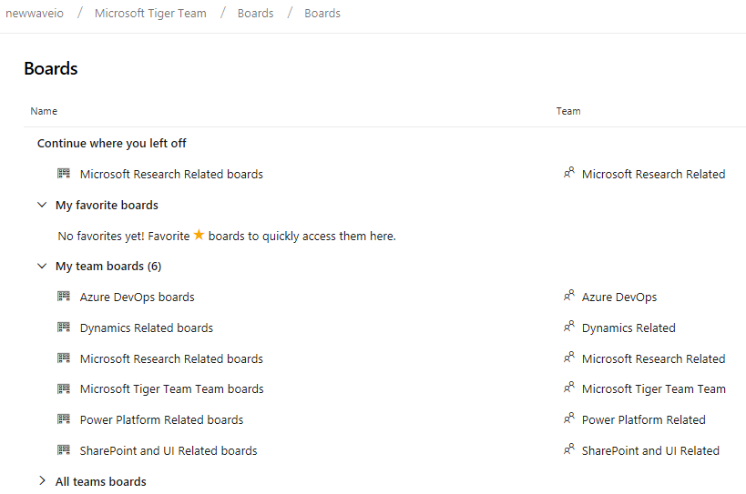
Creating Teams
3
Before creating Boards or planning, we need to have a team.
One project can have multiple teams based on the requirements and each team can have their separate boards
The picture on the right shows how to create teams inside the project.
2
1
Stakeholder: Team administrator or Project Manager

Slide 27
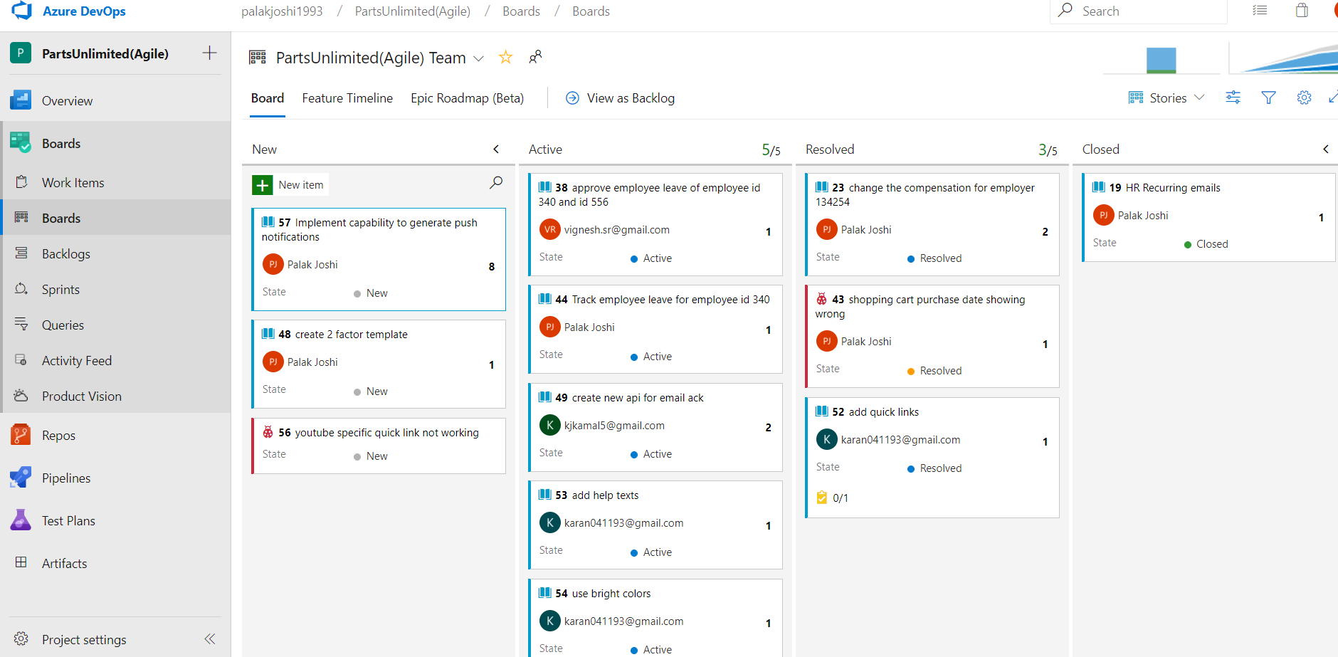
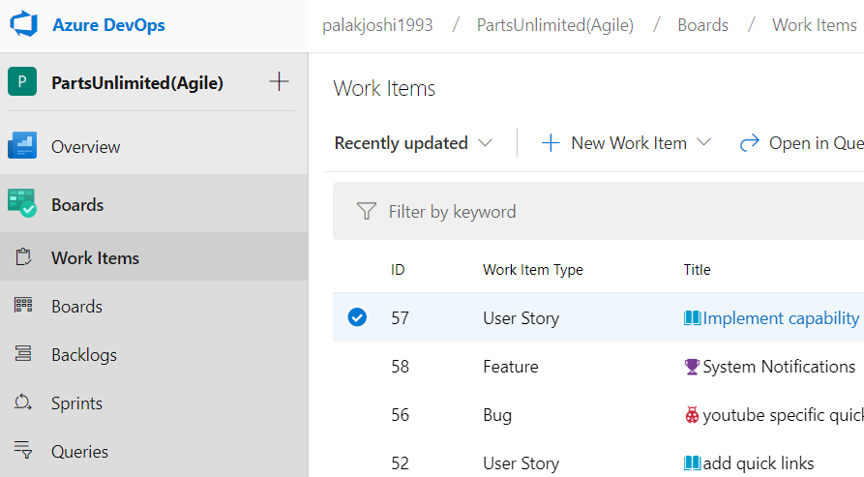
Adding items to the Board
Add a new user story or bug by clicking on “New Item”
Add a new work item by clicking on “New Work Item
Shows cumulative flow
Shows velocity
Select work item type (features/epics/stories)
or
Stakeholder: Project admin, Team admin, Developer
Please Note: Work items can be added from Boards → Boards or Boards→ Work Items

Slide 28
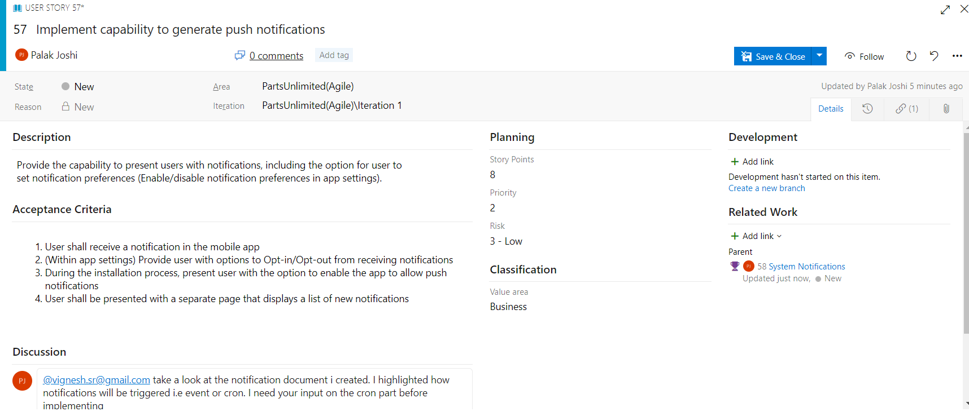
Adding user Story Details
Used to estimate work, build velocity charts and forecast (should be added only during sprint planning meeting)
Unique identifier assigned by the system
Assign work to teammates
View/add comments
Attach files to the work item
Audit history
Track progress
Act as filters. Helps to classify and search all work items
Rich text toolbar appears when you once click inside the box to add a short description to the story
subjective rating of the user story, feature, or requirement as it relates to the business
Link a work item
Each requirement will have a basic criteria which it should satisfy once deployed
rating of the relative uncertainty around the successful completion of a user story
Add and review comments, use @ to pull someone into the discussion
Stakeholder: Project admin, Team admin, Developer

Slide 29
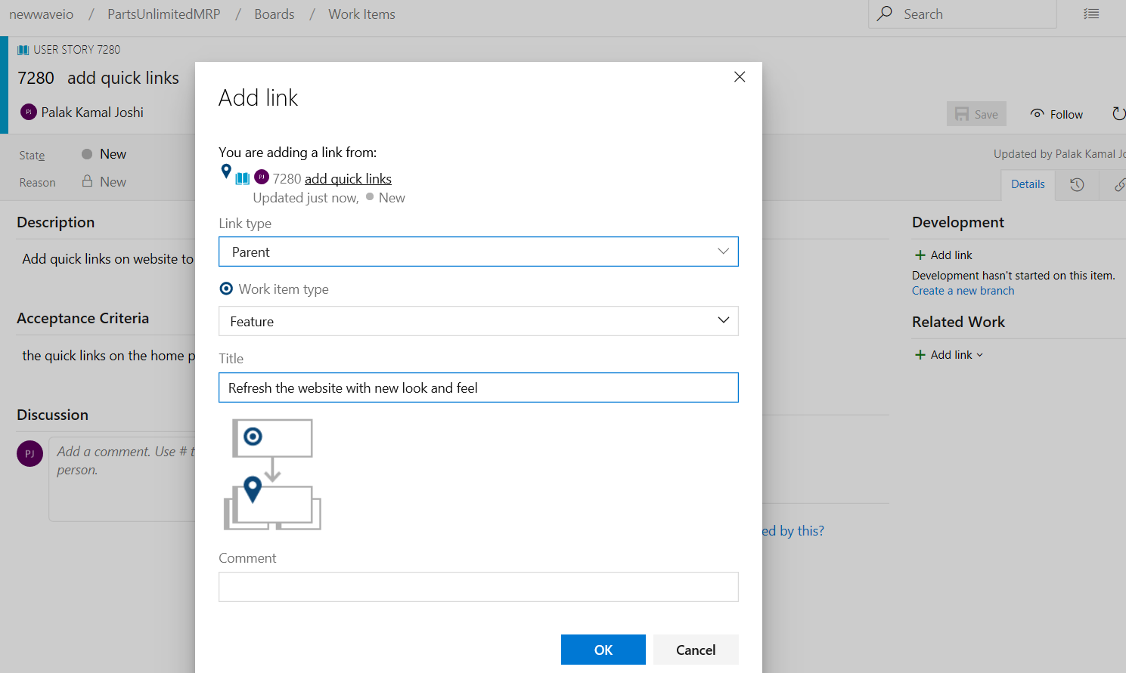
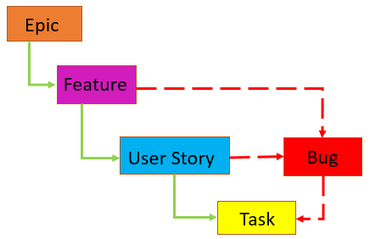
Add related work
Add a link with the link type (example parent or child)
Specify work item type, title and click on OK
It is very important that there are no orphan User Stories and Tasks

Slide 30
Adding User story cont’d
Lets look at the few important fields that help in better planning using Azure DevOps
Description
Focusses on who the feature is for, what users want to accomplish, and why
Based on this field team will write tasks and test cases to implement the story.
Acceptance Criteria
Defines what “done” means
Set of conditions used to verify if requirement is fully implemented
Clear acceptance criteria help with estimating and developing requirements with testing.
Help in understanding clients requirement better.
Story Points(Sprint Planning)
Provides enough details for estimating how much work will be required to implement the story.
Estimates the effort and work to deliver the highest priority items.
Used for forecast feature and velocity charts to estimate future work
Priority
It can be decided based on 3 points:
1: Product cannot ship without the feature.
2: Product cannot ship without the feature,
but it doesn't have to be addressed immediately.
3: Implementation of the feature is optional based on resources, time, and risk.
Area and iteration
Area paths allow you to group work items by team, product, or feature area.
Iteration paths allow you to group work into sprints
Discussions
@ → add team member or a team
# → link a work item
! → link a pull request
Get updates about the work being performed

Slide 31
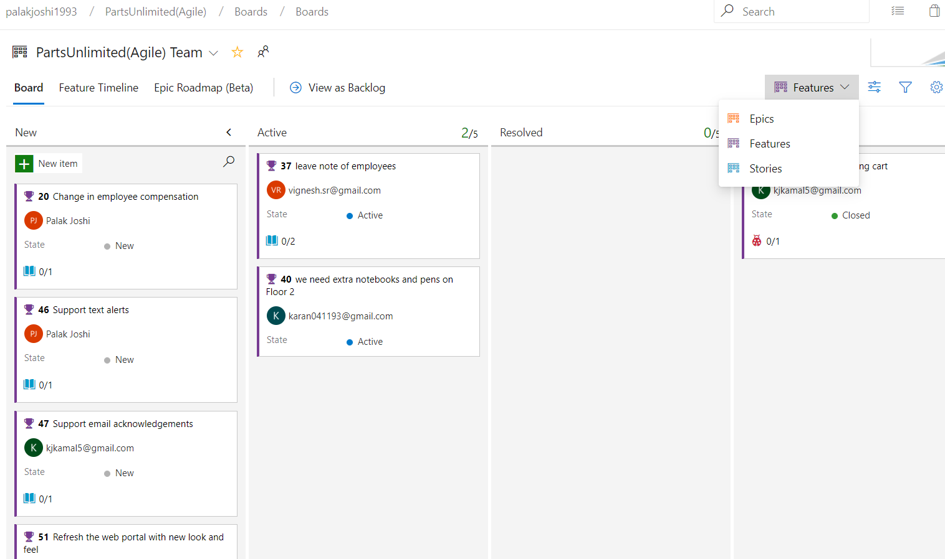
Boards view based on work items
Feature
Associated Bug
Associated story

Slide 32
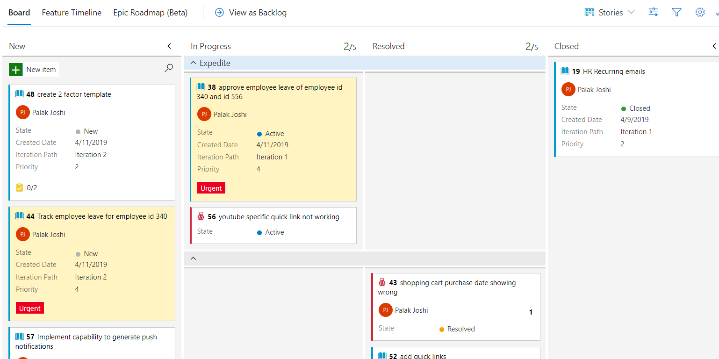
Azure Boards - Cards
Settings
Ideally there are 4 columns(also called Phases), New, Active, Resolved and closed.
Customize columns → settings > Board > Columns.
Customize user story cards → Settings > Cards > Fields(contain preloaded metrics).
Set some styles, colors and add tags to customize the cards further.
Add Swimlanes → Settings > Boards > Swimlanes.
Provision for setting priority
Out of 5 stories, 1 story needs to be expedited within this release cycle, then you can create a swimlane called “Expedite”
This lets developer about the high priority work.
Drag and drop tasks in the swimlanes.
Stakeholder: Project admin, Team admin
Additional link on Plan work with Azure DevOps: https://www.youtube.com/watch?v=wOCDyv4k4vA & https://www.youtube.com/watch?v=SbFKi6Hflc0

Slide 33
Demo – Azure Boards

Slide 34
Demo – Azure Boards
Please click below links
Boards
https://youtu.be/J9ATmMbH8jA
Bug Management
https://youtu.be/s-OIgFzIlrA

Slide 35
Backlogs

Slide 36
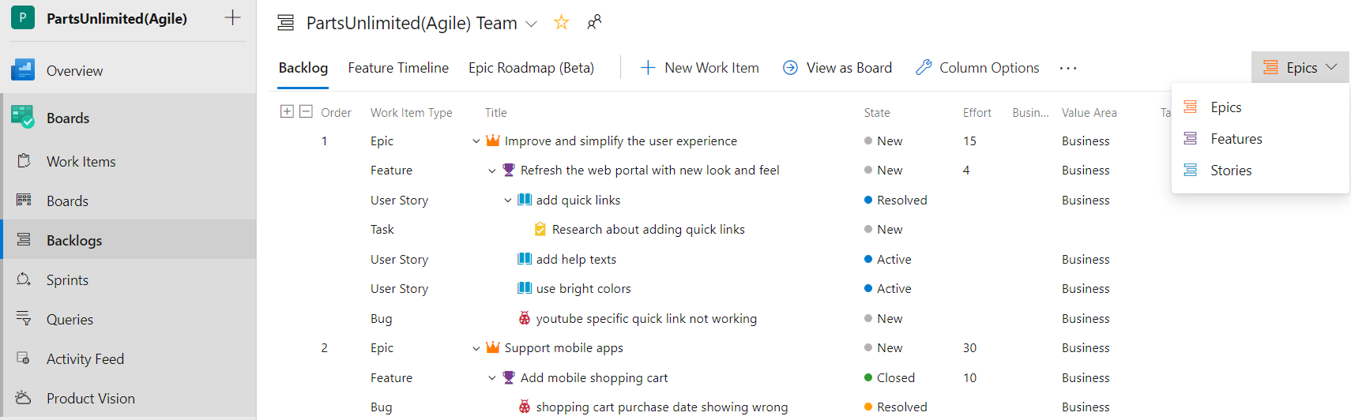
Backlogs
Select the work item from dropdown to be viewed as a backlog.
View hierarchy of related work items as shown in image below with their current state and efforts involved.
Please note: Feature Timeline, Epic Roadmap, Activity Feed and Product Vision are extensions installed from MarketPlace. They will not be seen by default when you start a new project
Stakeholder for adding backlogs: Project admin, Team admin, Contributor

Slide 37
Sprint and Capacity Planning

Slide 38
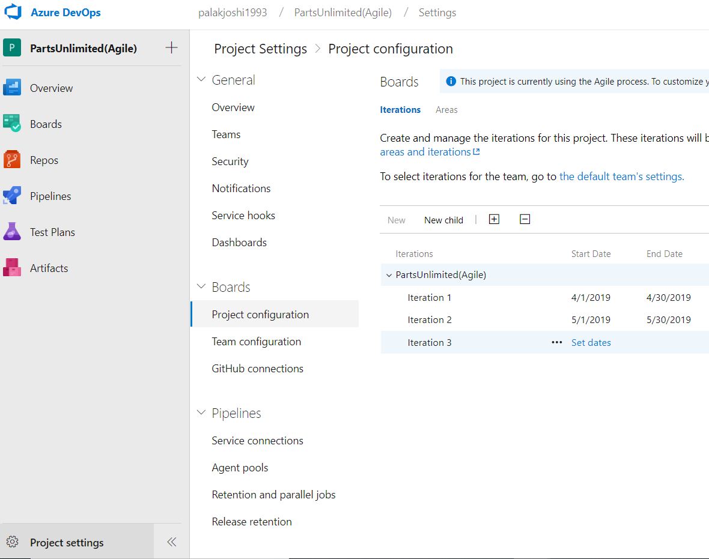
Iterations
3
Choose (1) Project Settings, expand Boards if needed, and choose (2) Project configuration and then (3) Iterations (4) set dates
Set dates for each sprint/iterations
2
4
1
Stakeholder: Project Admin or Team Admin

Slide 39
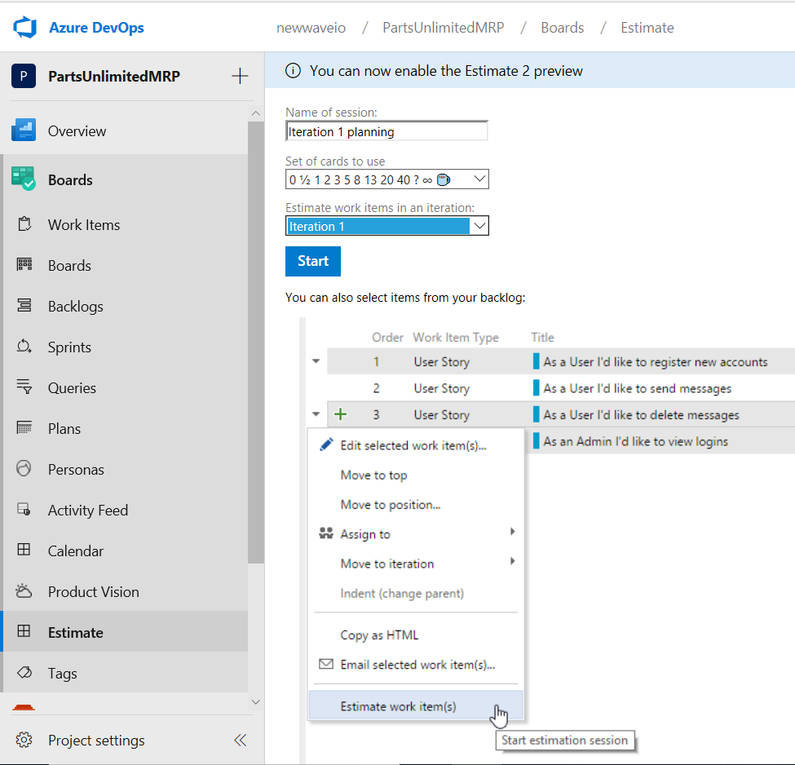
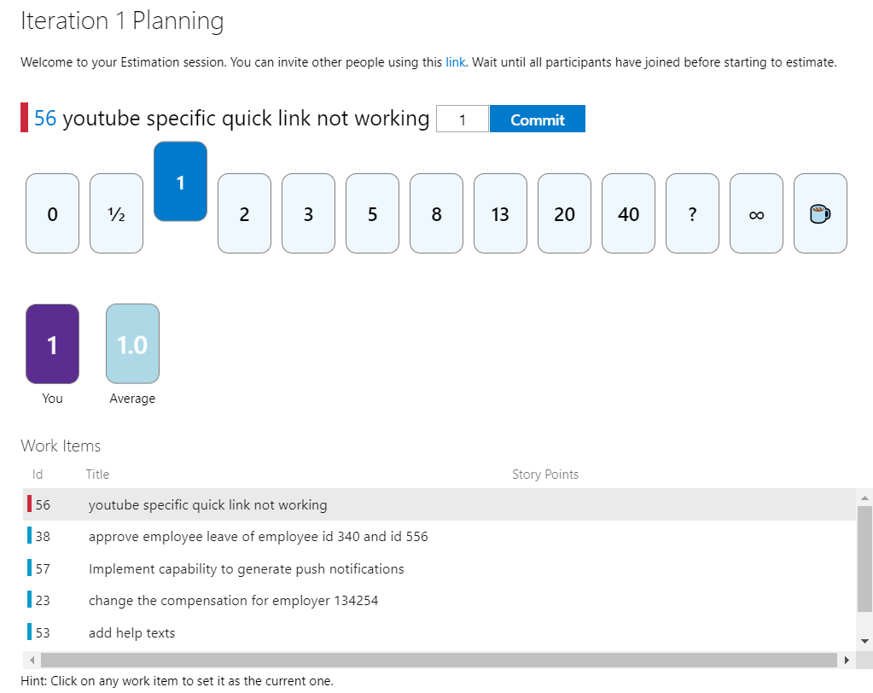
Step 1: Estimating story points
Can use a tool called “Estimate” from marketplace to get team’s votes on each story points.
Click here
Stakeholder: Project admin, Team admin, Developers

Slide 40
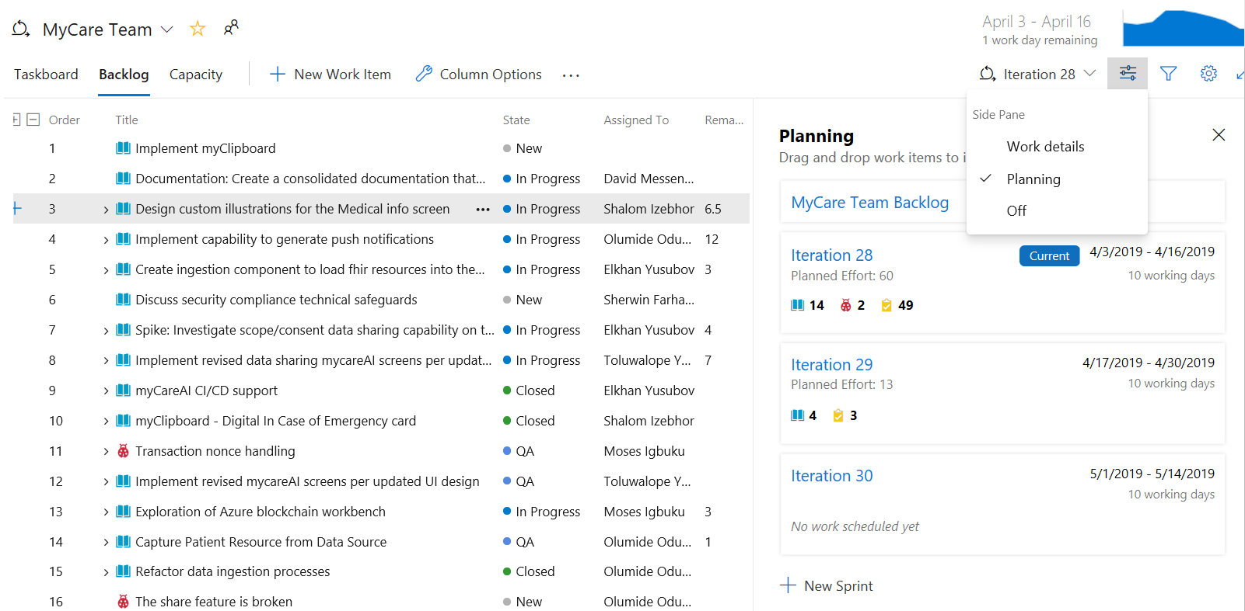

Step 2: Adding backlogs item to a Sprint
Burndown for current iteration
Enable Planning to drag and drop user stories to iterations/sprints.
Supports adding items to future iterations
Planned Effort provides a sum of all Story Points or Effort defined for backlog items assigned to the sprint.
Stakeholder: Project admin, Team admin, Developers

Slide 41
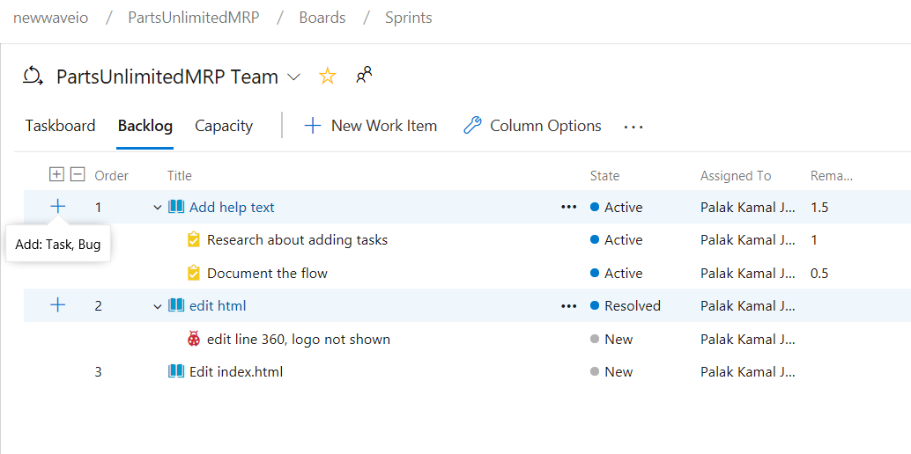
Step 3: Add tasks
Option 1
2 Ways: Taskboard (option 1) & Backlog (option 2)
From the Backlog view, choose the plus sign to open the work item form for a task(option 2).
Tasks can be added to User Story or a Bug.
Enter Remaining Work
At the planning stage, Remaining Work corresponds to an estimate of how long it will take to complete the task.
A good rule of thumb is to size tasks to take no more than a day to complete. If a task is too large, the team should break it down.
Option 2
Stakeholder: Team admin or Developers

Slide 42
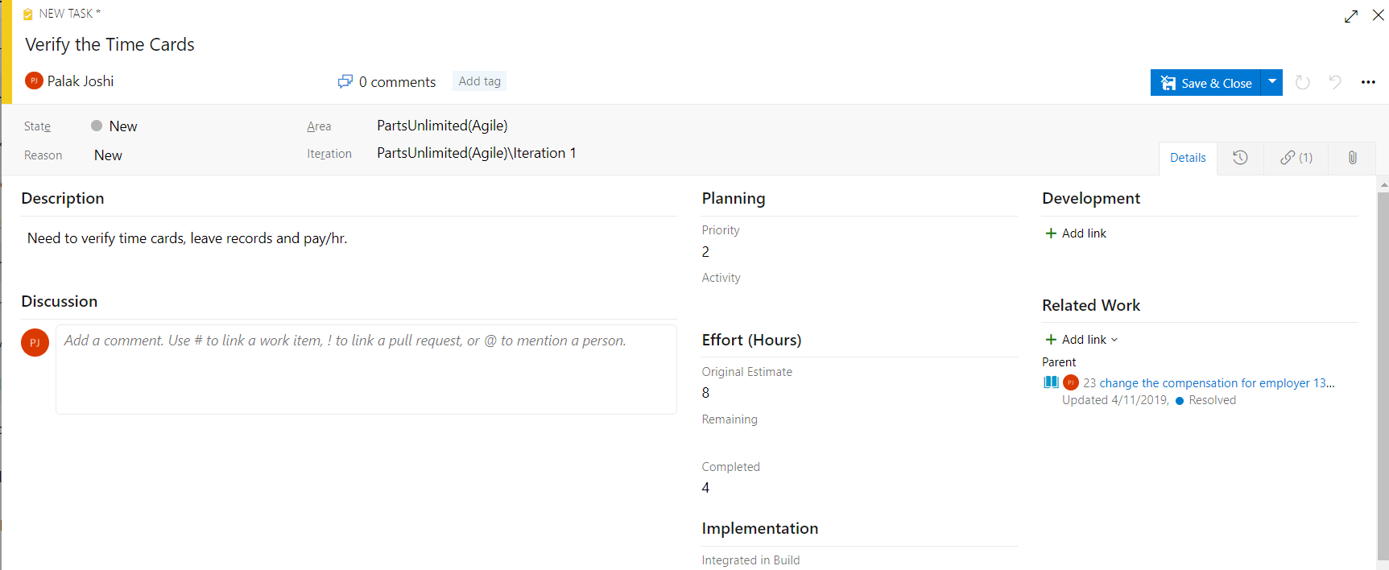
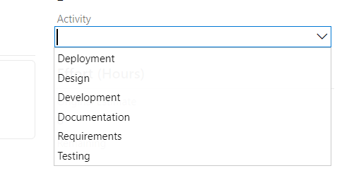
Add tasks Cont’d
During the sprint, team members update remaining work to continually reflect the time required to complete the task.
This value can actually increase after work begins. For example, after working 4 hours on a task that was estimated to take 8 hours, the team member realizes he needs 16 hours over what he estimated. He would update the Remaining Work field with 20 (8-4+16).
20
Field | Usage
Original Estimate | estimated work required to complete a task Does not change once assigned
Remaining | The amount of work remaining to complete a task. As work progresses, update this field Used for calculate capacity charts and sprint burndown charts
Completed | The amount of work spent implementing a task.
Activity dropdown: Select the type of activity this task represents when your team estimates sprint capacity by activity.

Slide 43
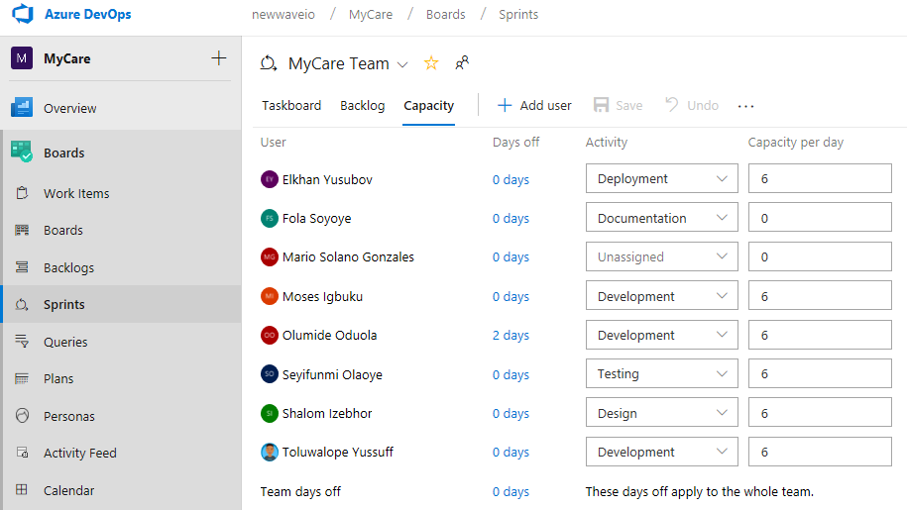
Step 4: Set Capacity
Capacity correlates to actual task time, either hours or days, that an individual or a team has to work.
By setting team capacity, the team knows exactly the total number of work hours or days the team has for each sprint.
Stakeholder (set capacity): Team admin or Project Manager

Slide 44
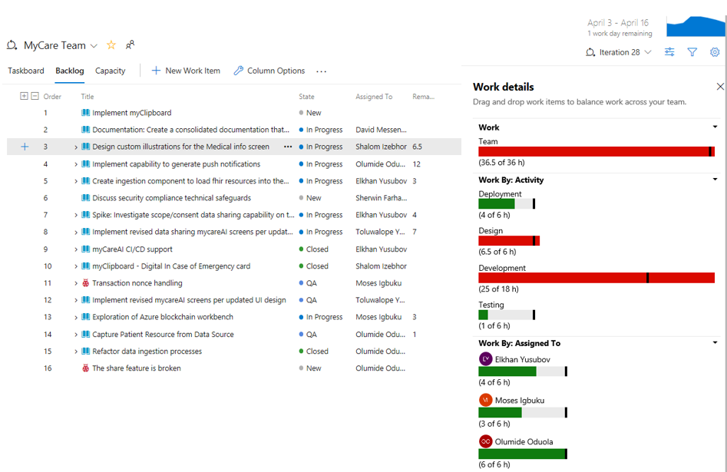
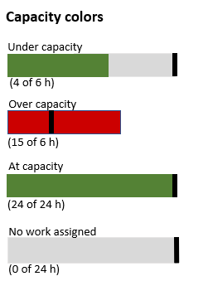
Step 5: See work details
Burndown for current iteration
Click here to enable work details
In the drop-down options (image on previous slide) enable work details to see if the team or a team member is at, under, or over capacity.

Slide 45
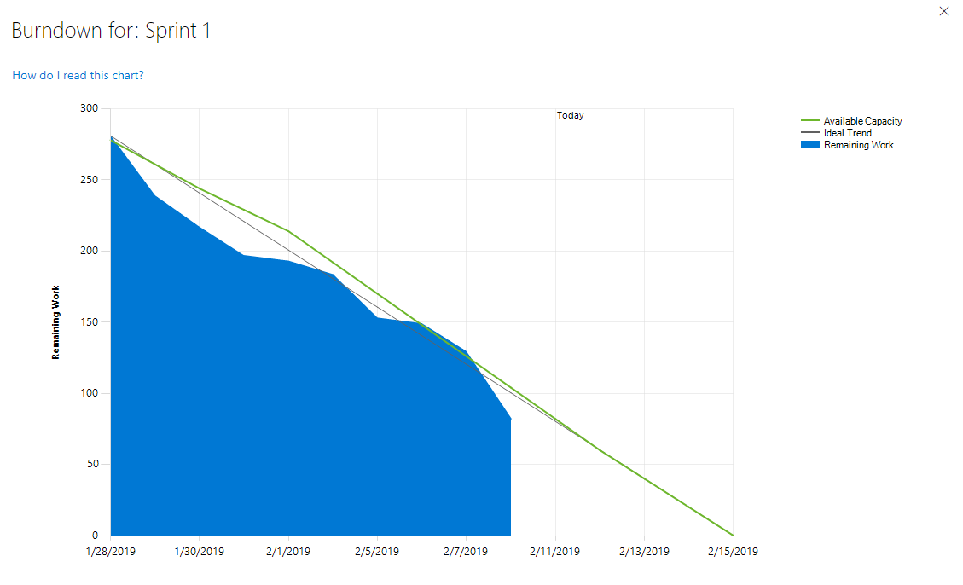
Burndown chart
Reflects the progress made by a team in completing all the work they estimated during their sprint planning meeting
The blue area, represents what's actually going on. It sum of all Remaining Work set for all sprint tasks, and possibly bugs for current iteration.
It shows the buildup of work as team members add tasks and the reduction of work as team members complete those tasks
It typically looks like a downward trending graph with some ideal line.
Related Link: https://docs.microsoft.com/en-us/azure/devops/boards/sprints/sprint-burndown?view=azure-devops

Slide 46
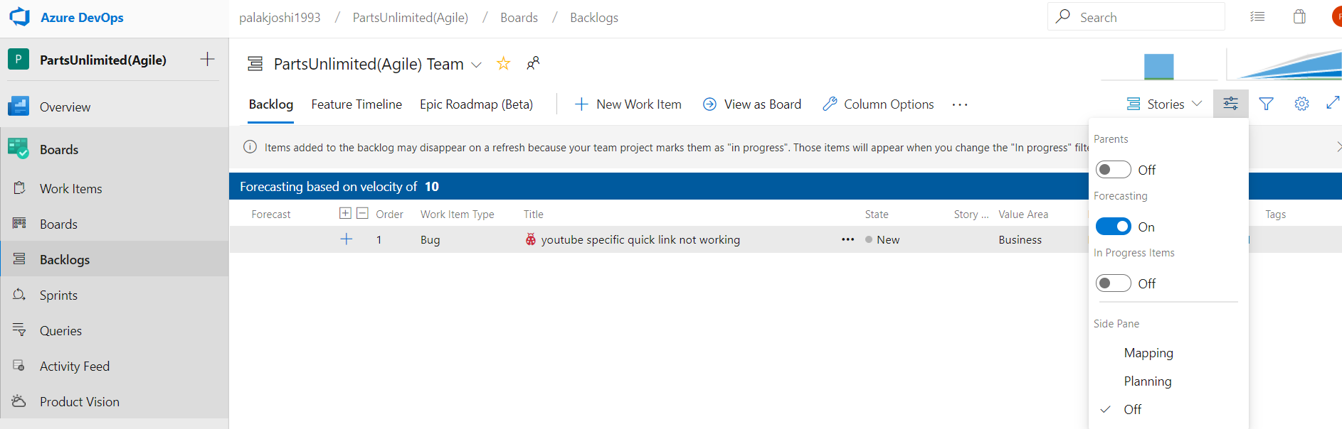
Forecast
Use:
Used to get an idea of how many items you can complete within a sprint
Method:
Set Mapping and Planning panes Off.
Set In Progress Items to Off to hide those items that won't be counted in the forecast.
The forecast tool ignores scrum items set to Active, Resolved, or Completed.
Once the forecasting is enabled, you get the velocity bar
1
3
4
2
Stakeholder: Developers and Team admins

Slide 47
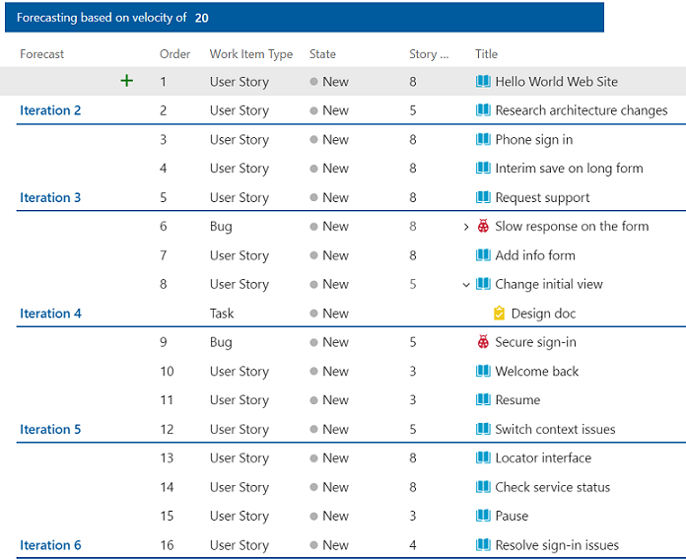
Forecast lines
Forecast tool draws Forecast lines for each future sprint selected by the team which shows how much work your team should be able to complete in future sprints.
Items above the first line are already in progress for the current sprint. (red brace)
Items that fall between the first and second forecast lines indicate what can be completed in the named sprint. (green brace)
Additional link for Sprint planning, backlogs and capacity: https://www.youtube.com/watch?v=s6lhaS6bcPs

Slide 48
Demo – Sprint and Capacity Planning

Slide 49
Demo – Sprint and Capacity Planning
Please click below links
Part 1
https://youtu.be/JNPlvqhdlzI
Part 2
https://youtu.be/v_1HzZetl6g
Part 3
https://youtu.be/xdN0TjvjxHM
Part 4
https://youtu.be/NdNsO1Ghz44

Slide 50
Queries

Slide 51
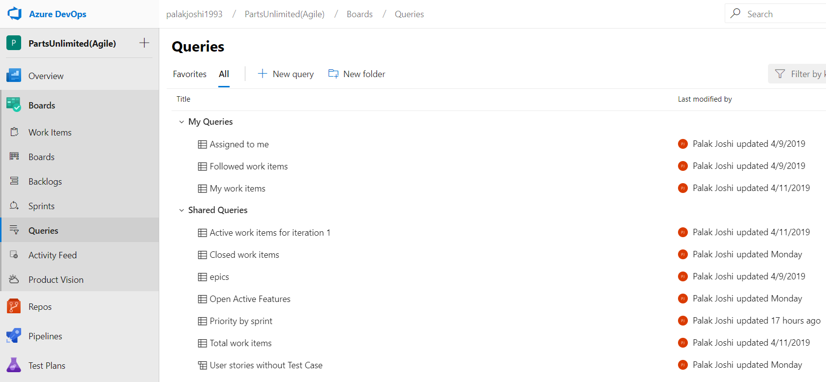
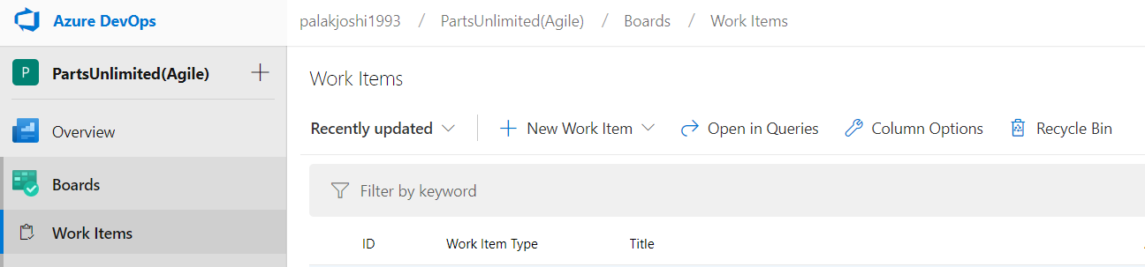
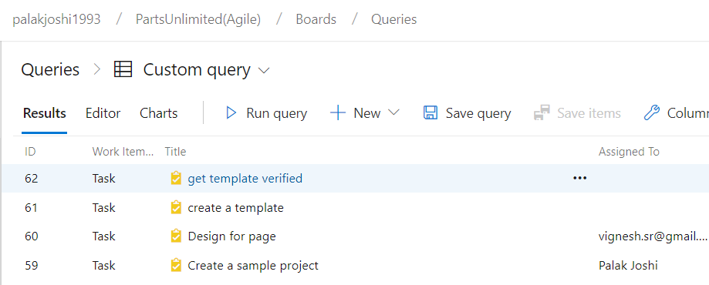
Can create separate folders depending on the type of queries for example – current sprint (contains all queries for current iteration only)
Queries
A query lists a filtered set of work items.
You can initiate a query using the query editor or Work Items tab
Not shared to other users
or
Can be pinned on the dashboard
Stakeholder: Developer, Team admin, Project admin

Slide 52
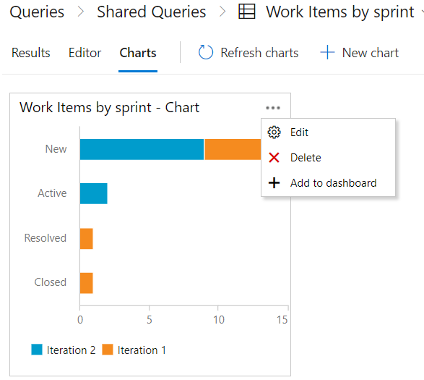
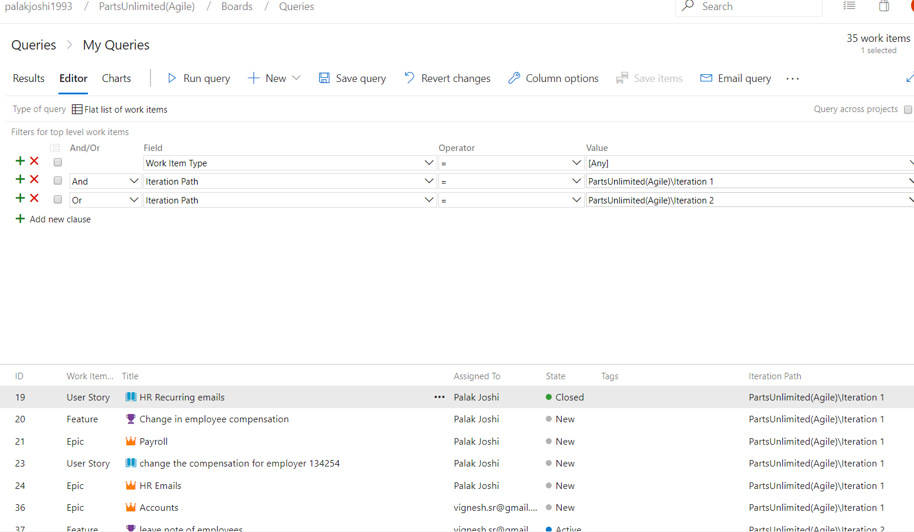
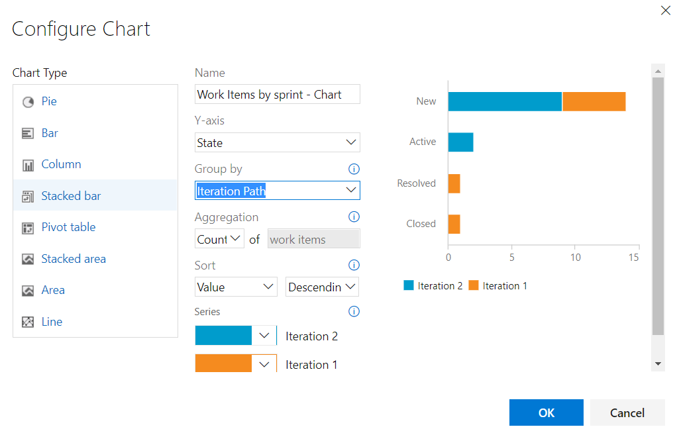
Queries cont’d
Example: Create a Query for all work items for iteration 1 and iteration 2
You create a query by defining one or more clauses. Each clause defines a filter criteria for a single field.
Stakeholder: Developer, Team admin, Project admin
Additional link: https://docs.microsoft.com/en-us/azure/devops/boards/queries/titles-ids-descriptions?view=azure-devops

Slide 53
Dashboards

Slide 54
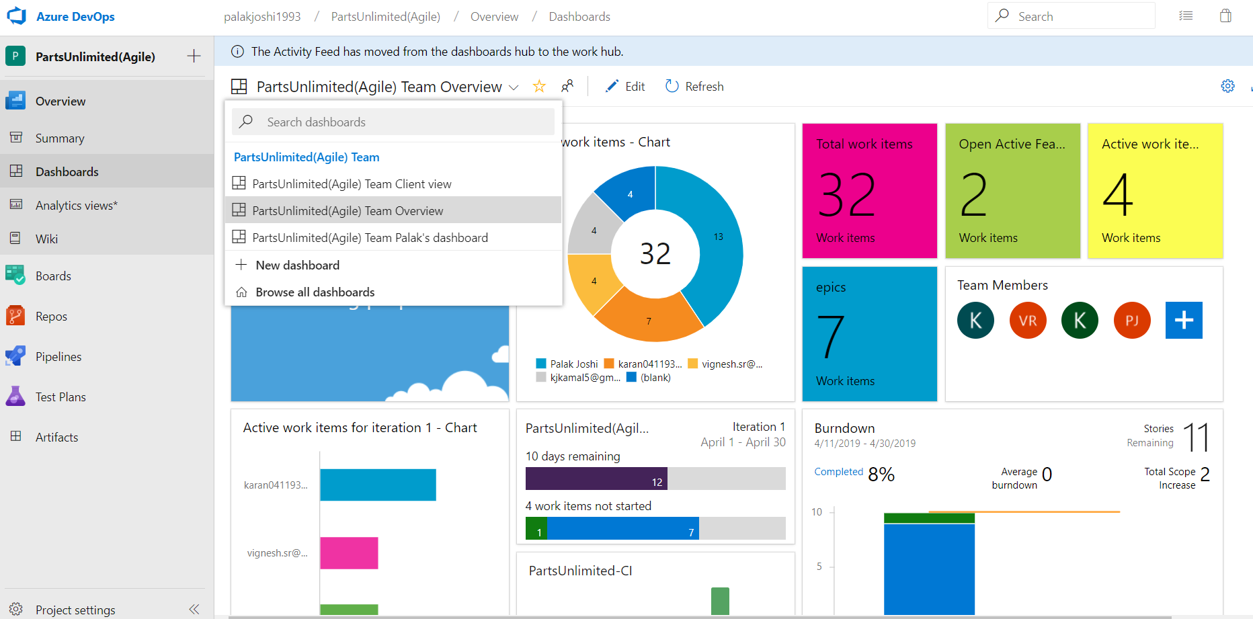
Fully customized dashboard for each team with multiple views
Click on edit to add widgets
Stakeholders: Team Admin, Project Manager, Developers with permission set
Additional link for dashboards: https://www.youtube.com/watch?v=61B_pL7Uj0Q

Slide 55
Widgets

Slide 56
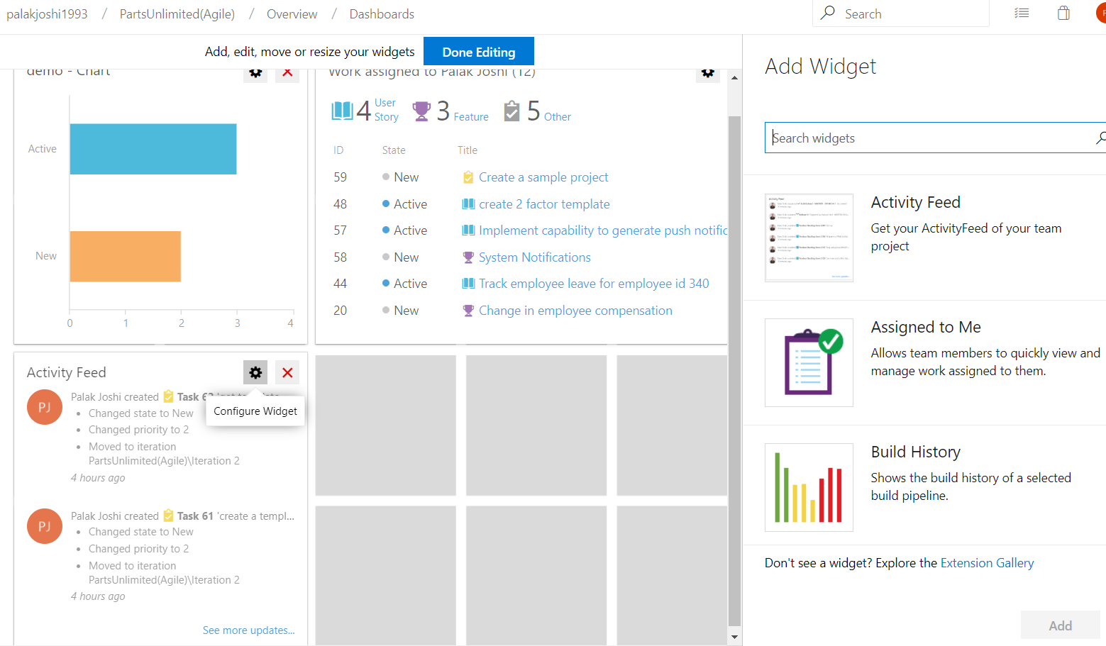
Add Widgets
Use:
Gain visibility into the status and trends occurring.
Method:
Click on Edit(as shown on slide 45)
Drag and drop the widgets on the dashboard.
Can add up to 200 widgets total.
Click on Configure Widget to customize.
Drag Drop
Additional link for Azure Dashboards – widgets: https://www.youtube.com/watch?v=oqor4duK5aY

Slide 57
Demo – Queries, Dashboards, Widgets

Slide 58
Demo – Queries, Dashboards, Widgets
Please click below links
Part 1
https://youtu.be/xhr4wRExgrI
Part 2
https://youtu.be/VUW1zZ23NbY
Part 3
https://youtu.be/Z2Jyhwipb8A

Slide 59
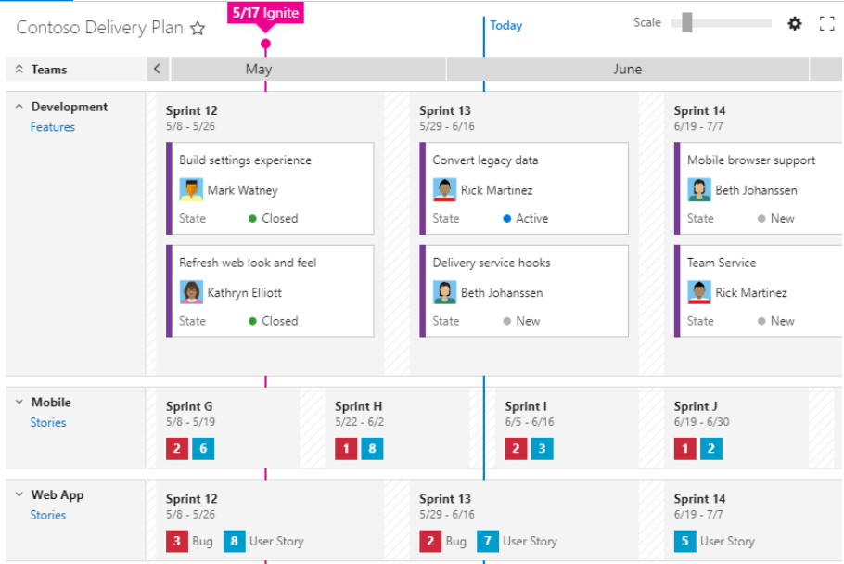
Delivery Plans
Delivery Plans is an organizational tool that helps users drive cross-team visibility and alignment by tracking work status on an iteration-based calendar.
It is available in Visual Studio Marketplace.
Users can tailor their plan to include any team or backlog level from across projects in the account.
Use field criteria – customize view by specifying conditions such as "Tags contains" or "Risk = High“.
Add markers to highlight key dates on your plan such as important events and ship dates

Slide 60
What is Version Control?

Slide 61
What is version Control?
Version control systems are software that help you track changes you make in your code over time.
Benefits:
Work with versions
Create workflows - prevent the chaos of everyone using their own development process with different and incompatible tools
Code Together
Keep a history
Automate tasks

Slide 62
Git best practices

Slide 63
Git commands
Lets look at the basic git commands:
Git Task | notes | commands
Clone | Create a working copy of a local repository (only first time) | git clone /path/to/repository
status | List the files you've changed and those you still need to add or commit | git status
Add Files | Add all files changed in a commit | git add <filename> or git add .(for all files)
Commit | Commit the changes | git commit –m “commit message”
Pull | Fetch before merging to get latest code and merge code changes | git pull origin <branchname>
Push | Send changes to a branch | git push origin <branchname>
Branches | Create a new branch and switch to it | git checkout -b <branchname>
 | Switch from one branch to another | git checkout <branchname>
 | To find what branch you're currently in and also list all branches in your repo | git branch

Slide 64
Git best practices
Ideally you can have 3 release cycles. There is a main master branch, R1, R2, R3 and each would be at different stages
R1 – production like staging, R2 -testing, R3 – development
This is important because main branch should be stable.
Any code merged to main branch should be tested and then only deployed.
When issue is found in production, best way to handle is pull out another branch from master branch(as it has the latest code) called hot-fix (post-production) branch.(hot fix branch can be easily created by using command git branch <branchname> and developer can pull that branch using git pull origin <branch name>)
You can swap between branches using git checkout <branchname>
There is shorthand command to create the branch and the swap to it at the same time git checkout –b <branchname>
After the issue is resolved in hot fix branch, code should be tested, deployed and again merged to the main branch – this is called Reverse Merge.
Stage your changes with git add –all – to add new files
git rm – to remove any files
git commit –m “<short description of the changes>” – to commit changes
git push origin <branch name> - to share you code
Whenever people are simultaneously working there might be possibility of overlapping. To avoid any conflicts, developer working on other branches should make sure to they have the latest code before they start their change.
If code change was introduced later they should make sure to pull the latest code before the reverse merge using the command git pull origin <branch name>
All the code changes going on the master branch should go to all the active branches.

Slide 65
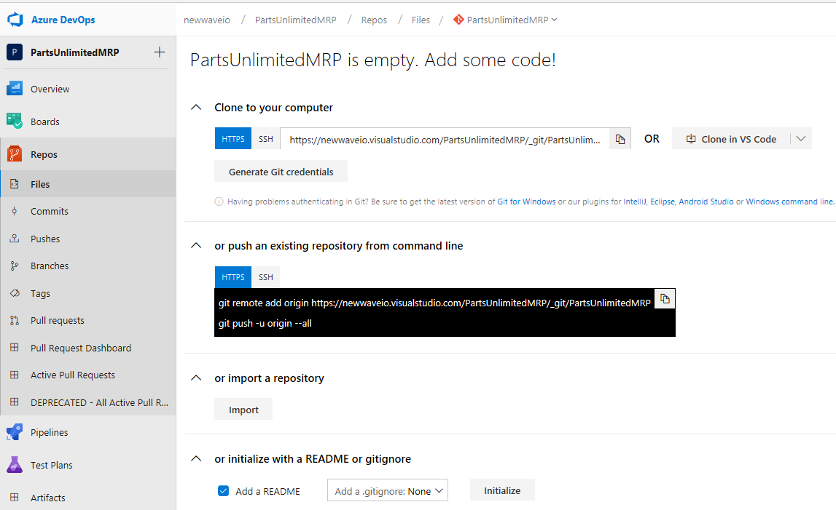
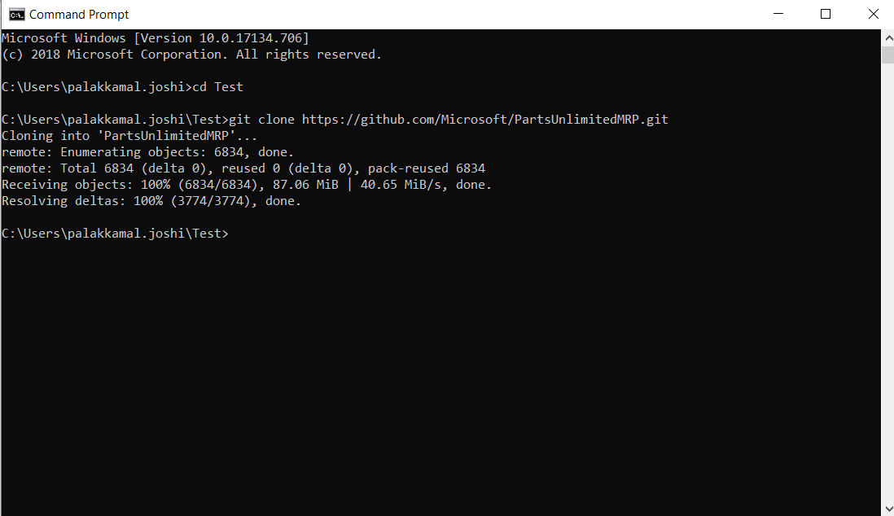
Git best practices step by step example
Clone the PartsUnlimitedMRP git repository located in GitHub onto your local machine, open your command line tool, and type :
git clone https://github.com/Microsoft/PartsUnlimitedMRP.git
Go to Repos → Files. The PartsUnlimitedMRP repository on Azure DevOPs
will be empty, so copy the Clone URL of the VSTS repository to your clipboard.
NOTE: If you are running Windows, you have to install the git client from here: http://git-scm.com/download

Slide 66
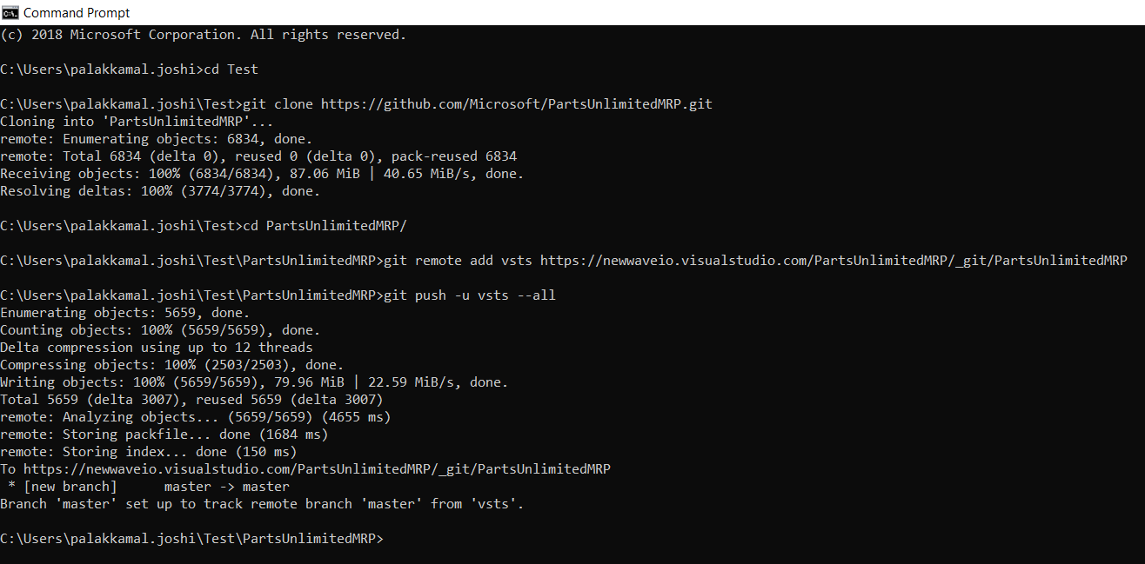
Git best practices step by step example cont’d
Add the Clone URL of your Azure DevOps repository as a new remote called vsts (The URL previously copied) and push to it to your Azure DevOps account.
Open the visual studio code or your preferred IDE to view and edit the code.

Slide 67
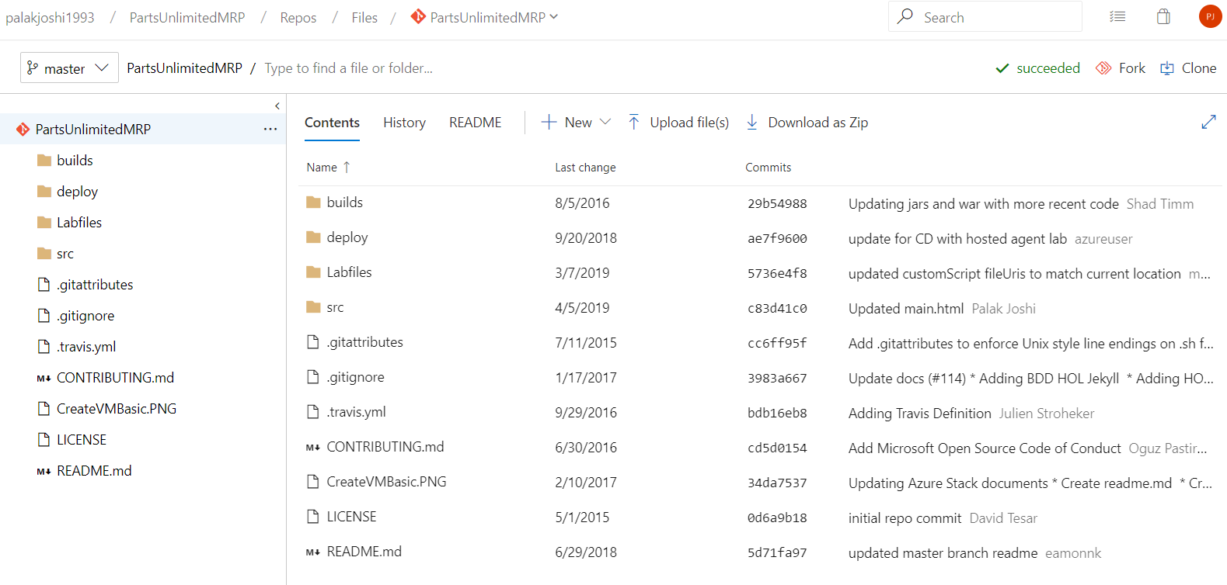
Git best practices step by step example cont’d
Go to Repos → Files and Refresh. Now we can see all the files from PartsUnlimitedMRP Github Repo.

Slide 68
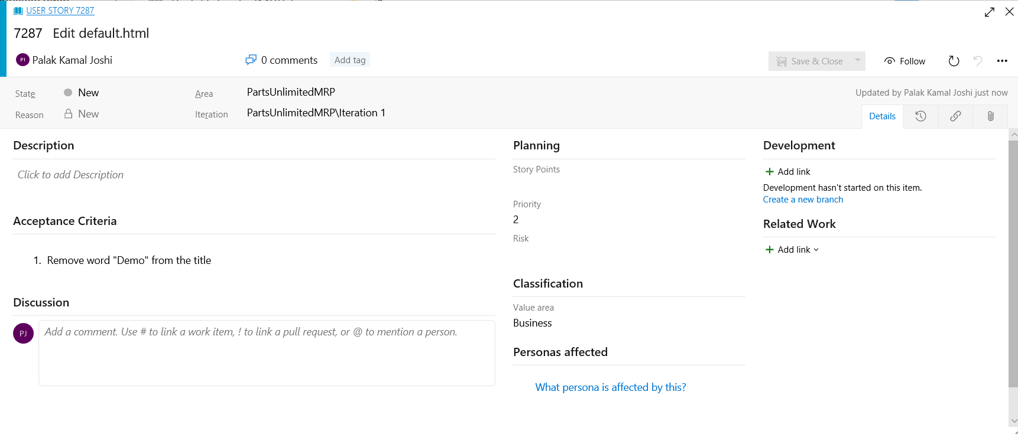
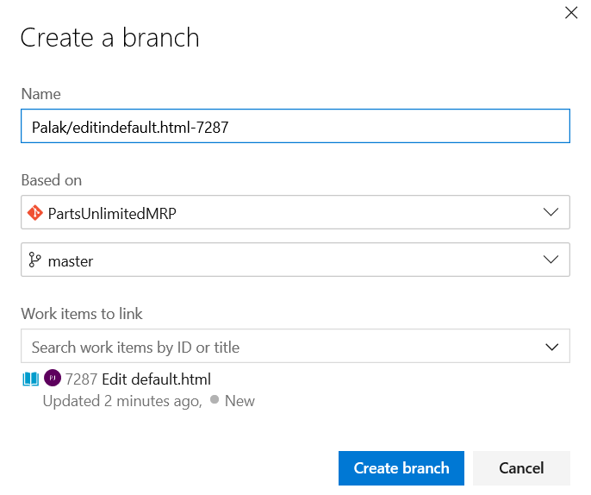
Git best practices step by step example cont’d
By writing name as Palak/editiindefault.html-storyuniqueidentifier>, the “Palak/” basically creates a folder by name Palak and so you can have all the changes created by you in that particular folder.
Create an isolated branch for fixing each User story/Task

Slide 69
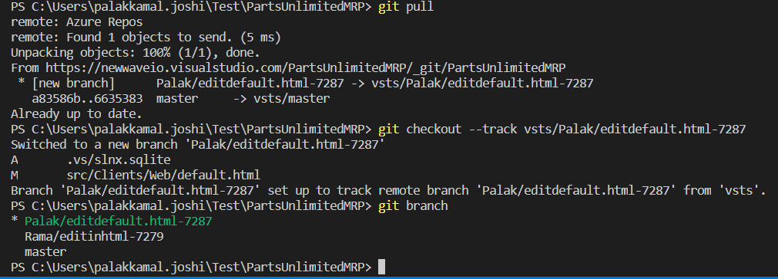
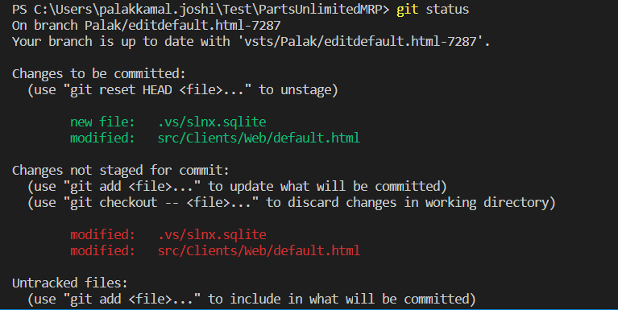
Git best practices step by step example cont’d
Go to the code IDE and pull the code
Once the change is completed, check all the modified files

Slide 70
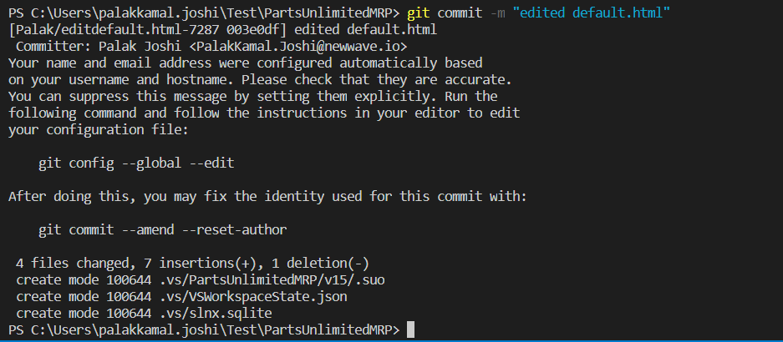
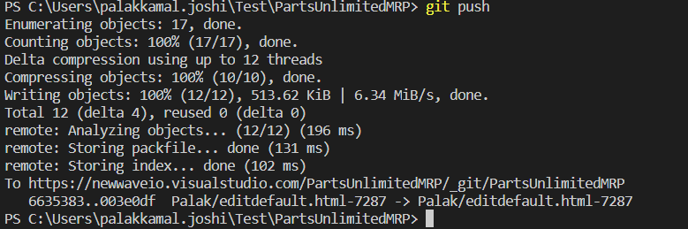
Git best practices step by step example cont’d
Once all the files are staged, using git add . Or git add <filename>
Commit all the changes
Push the changes from local repository to the branch selected. (here: Palak/editdefault.html-7287)

Slide 71
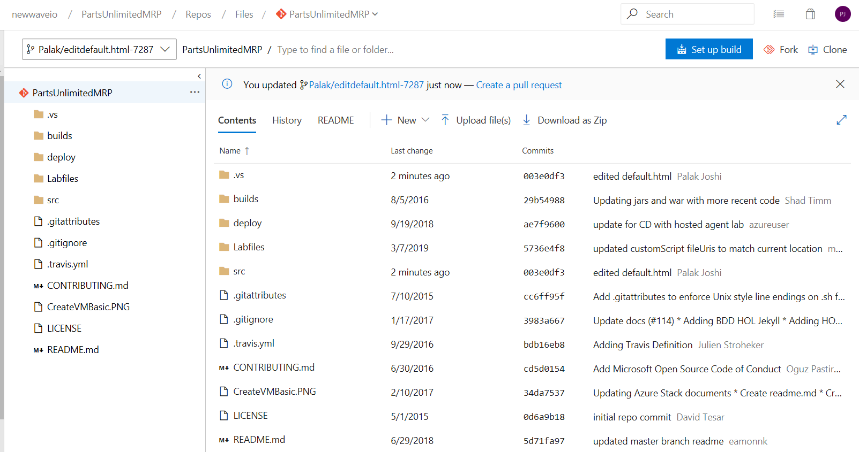

Git best practices step by step example cont’d
As soon as latest changes are pushed, go to Azure DevOps – Repos – Files
and when you refresh you can see option to “create a pull request”
Once you click on create here you can enter the reviwers
Best practice: At least two reviewers should review and approve the changes in a significant pull request.

Slide 72


Git best practices step by step example cont’d
Once clicked on complete, it will show 2 options – you can either
delete the branch
mark the associated work item as complete
Once completed it shows the screen as below
It will also show you if any conflicts in this same screen and you can fix them right here.

Slide 73
Feature Branching
The advantage of feature branching is that each developer can work on their own feature and be isolated from changes going on elsewhere. They can pull in changes from the main branch at their own pace, ensuring they don't break the flow of their feature.
There are options to resolve the conflicts whether you want to keep the incoming change, replace one with another or keep both the changes in feature release branches.
Feature branches
F2
Dev or Integration environment
F1
conflicts
Pulled before F1 Merged back
Staged branch
F1 Merge back
Resolve conflicts and
F2 Merge back
Push back latest code
Pull latest code to active branch
Main branch

Slide 74
CI/CD

Slide 75
CI/CD
Continuous integration, delivery and deployment are collectively referred to as continuous software development, and they are associated with the Agile and DevOps methodologies.
Continuous Integration
Continuous Deployment
Continuous Delivery
Enables developers to commit code into shared repository several times a day.
Each commit is automatically built and tested.
Bugs detected early
Automates the entire process from code commit to production if your CI/CD tests are successful.
Eliminates the human safeguards against unproven code in live software.
Important to apply real-time monitoring in production
Ensures that code and infrastructure are always in a production-deployable state
Usually involves a production-like staging area.
Changes need to be manually reviewed and accepted before pushing to production.

Slide 76

Comparison

Slide 77
DevSecOps & CI Flow

Slide 78
DevSecOps
Focusses on automating security groups to keep DevOps workflow from slowing down.
Ways to secure your organization:
Ensure all Azure DevOps users are in Azure Active Directory.
Manage Permissions
Control who can edit build and release definition for production
Incorporate Package Management
Continuously detect all the open source components in your software.
Create a local cache of approved components as well as make a trusted feed in the CI pipeline.
→ Tool - Azure Artifacts
Discover new security vulnerability and generate comprehensive inventory report for devops or security teams.
Automatically generate an alert for targeted remediation guidance
→ Tool - WhiteSource

Slide 79
Why Integrate Security Scanning into Your DevOps Pipeline???

Slide 80
Why Integrate Security Scanning into Your DevOps Pipeline?
Handy Extensions
Reduced Security Debt
Optimize Speed and achieve Automation
With new and easily installable extensions in marketplace, security scanning can be made a part of the release pipeline.
When scans are frequent, security warnings can be addressed in small batches – with each pull request or daily
By integrating security into the DevOps pipeline, it automates the process of creating, testing and deploying updates as this will shorten time to remediate when new vulnerabilities are discovered.
Safe Reuse
Accelerate Threat Scanning
With continuous scanning of packages, dependability on the packages increase with assurance that their vulnerabilities are not picked up.
New vulnerabilities can be discovered in the wild.
With immediate notification security intelligence can become actionable.
Scan the threats and vulnerabilities even before they are discovered by attackers

Slide 81

CI Flow

Slide 82
Summary:
What is DevOps and why is it important???
What is Planning and Importance of Agile
Brief overview of Azure DevOps and its features
Board planning and Work Tracking tips
Importance of Acceptance criteria when defining a user story and Mapping
Sprint and capacity planning, how to get Burndown charts for your team from Remaining work field defined for tasks
How to Forecast work items and determine team velocity???
Forming Queries
Use and customization of DashBoards
Git Best Practices
Brief introduction to CI/CD
What is DevSecOps, its advantages and how it can be incorporated in CI Flow
For support contact: palakkamal.joshi@newwave.io
vignesh.sunderrajan@newwave.io

